Slide 1
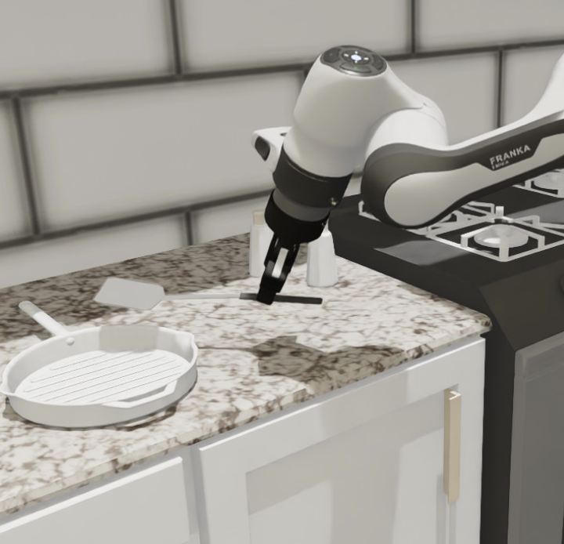
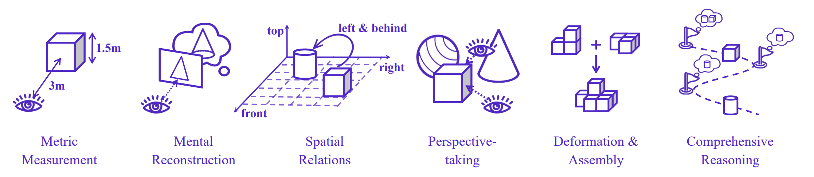
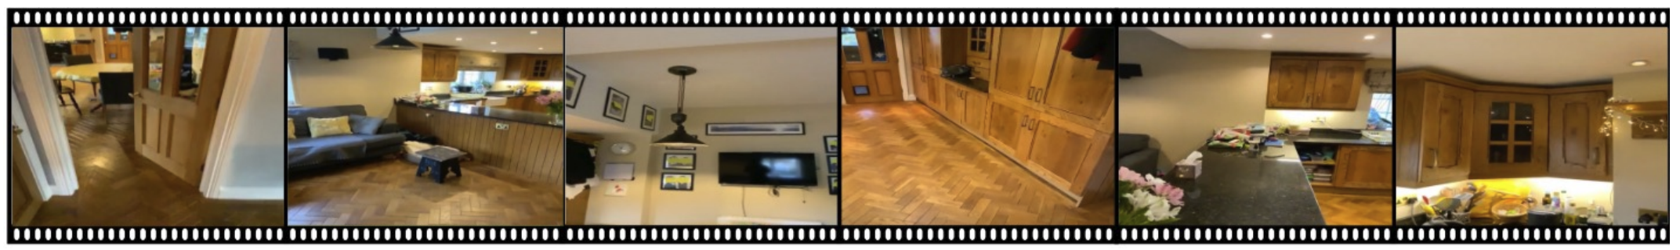
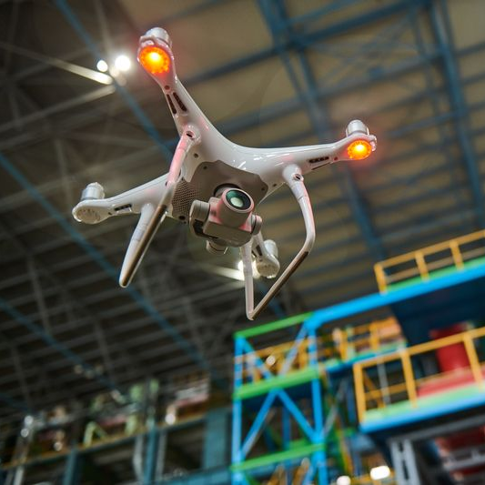
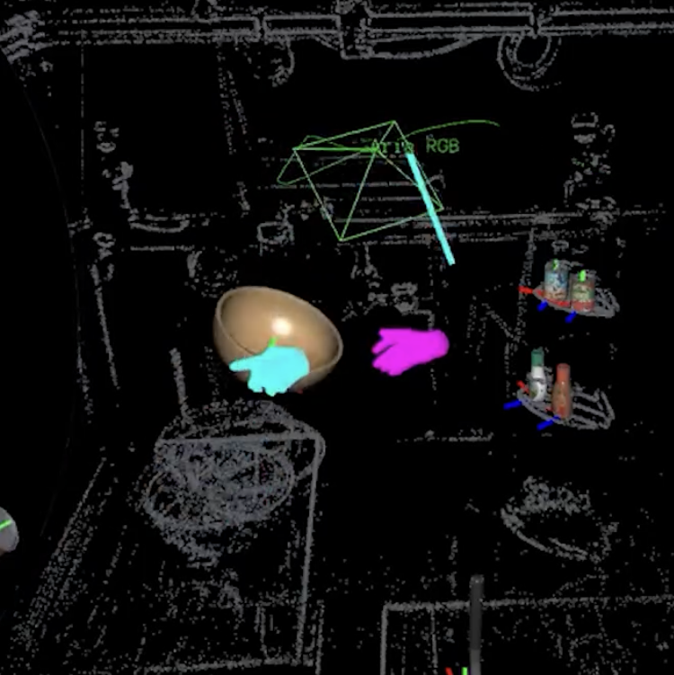
Fundamental Capabilities of Spatial Intelligence
Measurement
Mental reconstruction
Robotics Manipulator
Relative Relation
Perspective taking
Autonomous Drones
Egocentric Visual inputs
Mental rotation
Multi-step
Wearable AR
Basic Spatial Reasoning Capabilities
Spatial-aware Applications

Slide 2

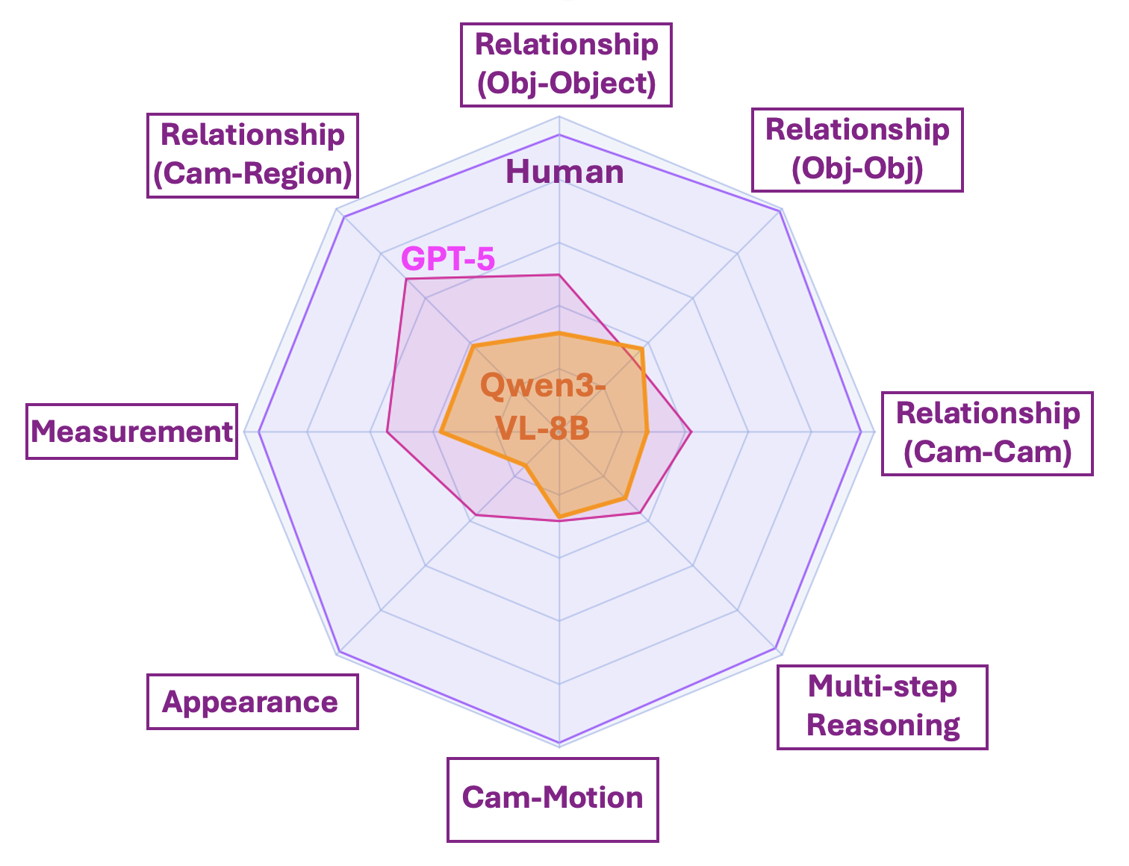
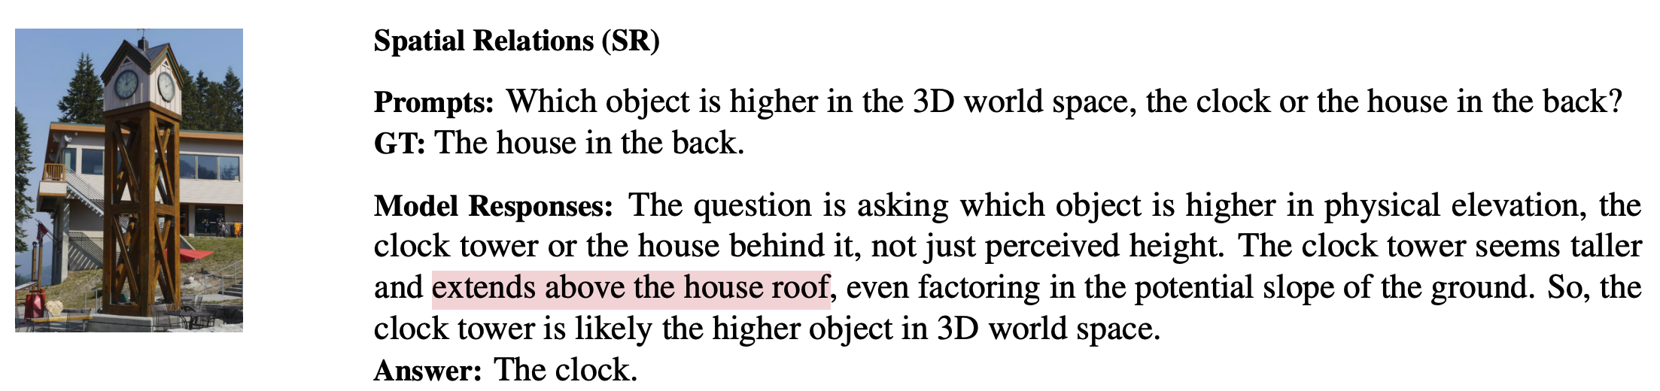

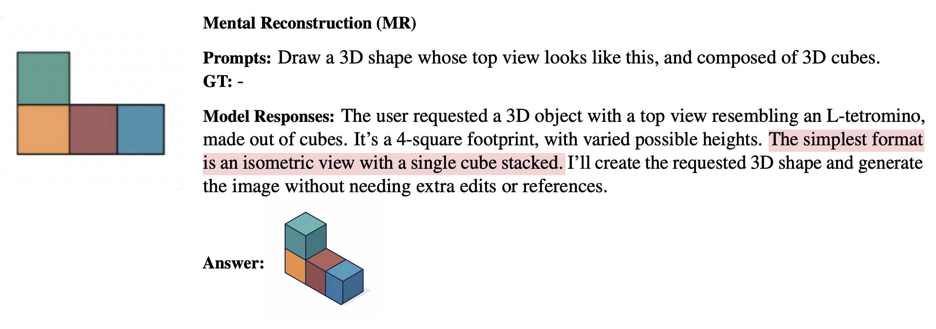
the performance gap between VLMs and humans
Reasoning based on 2d pixel space
Human VS Proprietary models
VS Open-sourced general models
Struggle in mental rotation
[1] Has GPT-5 Achieved Spatial Intelligence? An Empirical Study
[2] How Far are VLMs from Visual Spatial Intelligence? A Benchmark-Driven Perspective
Notes:
Has GPT-5 Achieved Spatial Intelligence? An Empirical Study

Slide 3
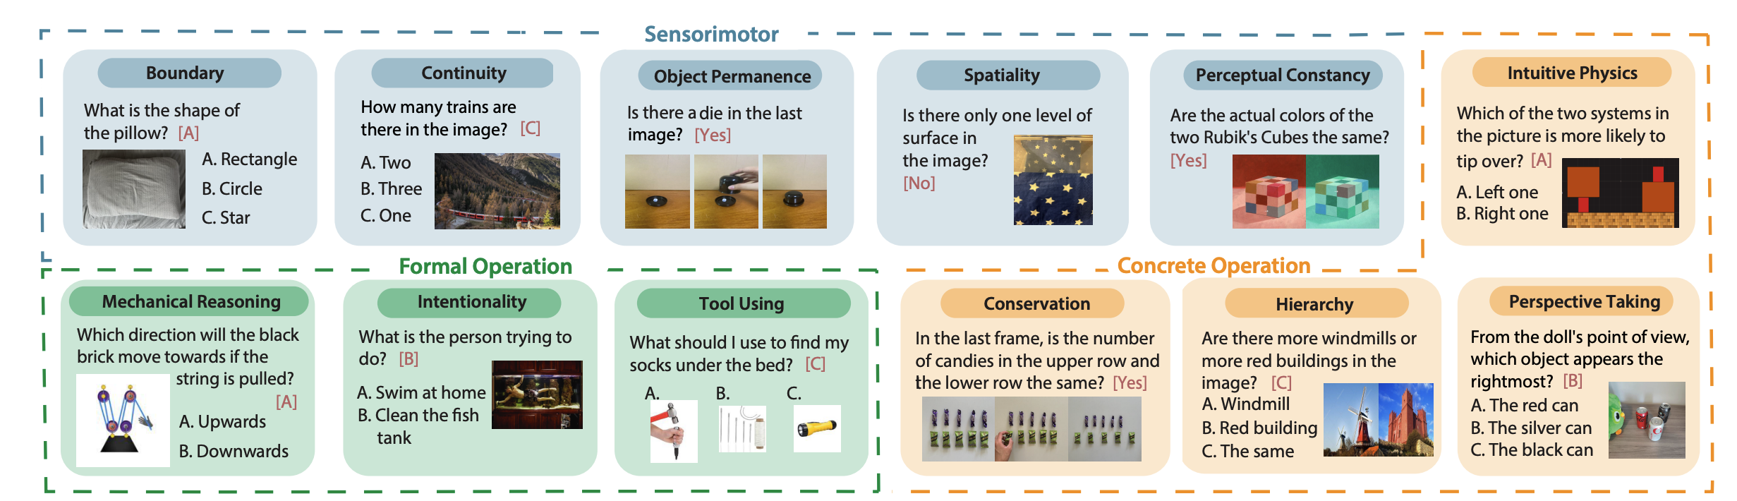
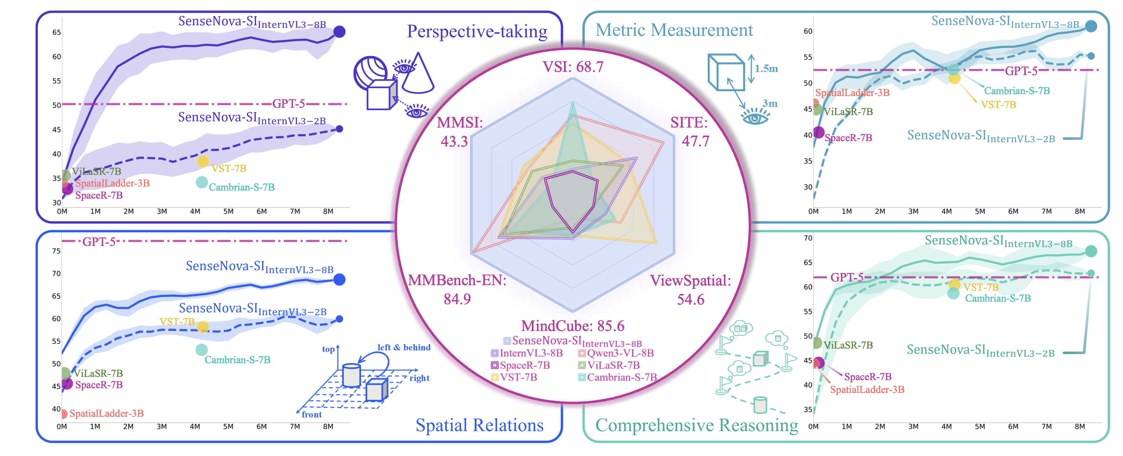
Can we solve spatial reasoning by further scaling training data and model size
Spatial reasoning is not "emerging" at the same rate as other language or vision capabilities
Basic cognition
Spatial reasoning
79
78
95
51
36
25
Human
GPT5
InternVL3
Human
GPT5
InternVL3
Measurement Task
Multi-step reasoning task
Performance
Performance
Plateaued after 2M data samples
Data volume
Data volume
[3] Why Do MLLMs Struggle with Spatial Understanding? A Systematic Analysis from Data to Architecture
[4] Scaling and Beyond: Advancing Spatial Reasoning in MLLMs Requires New Recipes
Notes:
Spatial reasoning is not "emerging" at the same rate as other language or vision capabilities; it appears to be a distinct capability that current architectures are struggling to learn from massive 2D data scaling alone.
Core Knowledge Deficits in Multi-Modal Language Models

Slide 4

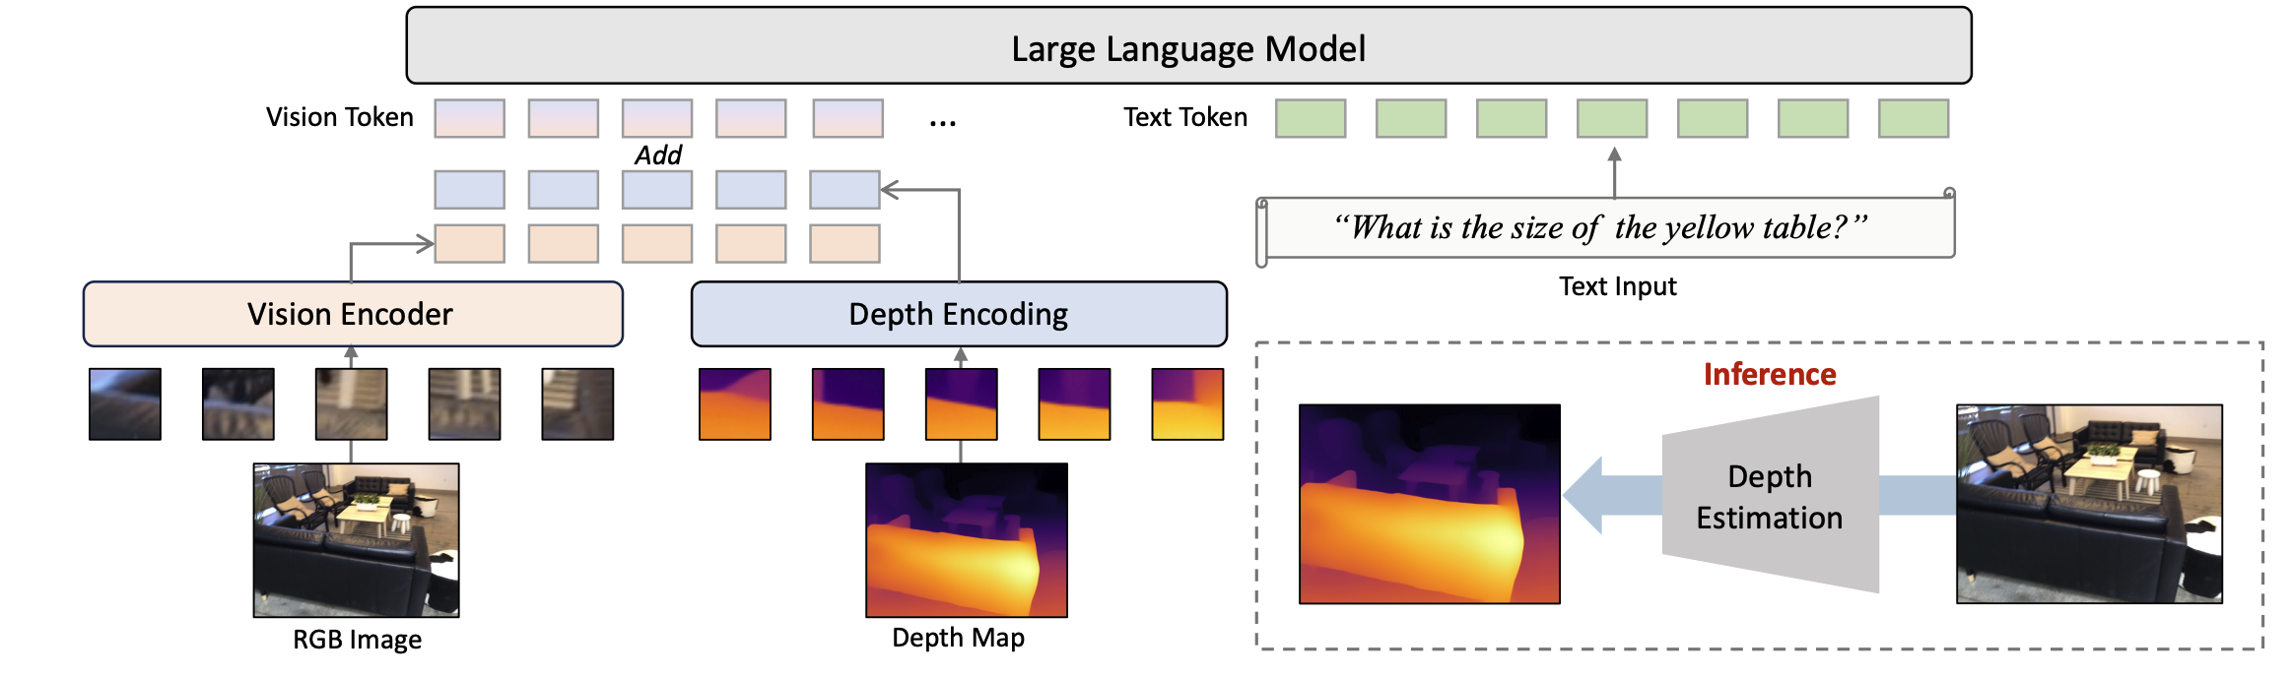

Scaling with diverse input modalities
Typical pipeline of adding new modality to VLM input layer
Finetuning LLM backbone
3D data Encoder
3D data
Limited improvement:
89
57
60
42
40
47
41
Human
Qwen3-VL-8B
InternVL3-8B
LLaVA-Video-72B
Spatial-MLLM
VST-7B-SFT
SpaceR-7B
General VLM
Fine-tuned with spatial data
Notes:
For example, if a question asks, "What object is typically found right next to the bed?", a text-only model can easily guess "nightstand" based on billions of pages of text data it has read. It doesn't need to look at the 3D room to get the answer right.
DO 3D LARGE LANGUAGE MODELS REALLY UNDERSTAND 3D SPATIAL RELATIONSHIPS?

Slide 5
Scaling with diverse input modalities
[5] Learning from Videos for 3D World: Enhancing MLLMs with 3D Vision Geometry Priors
[6] S2-MLLM: Boosting Spatial Reasoning Capability of MLLMs for 3D Visual Grounding with Structural Guidance
[7] SD-VLM: Spatial Measuring and Understanding with Depth-Encoded Vision-Language Models
[8] SpatialRGPT: Grounded Spatial Reasoning in Vision Language Models
Notes:
For example, if a question asks, "What object is typically found right next to the bed?", a text-only model can easily guess "nightstand" based on billions of pages of text data it has read. It doesn't need to look at the 3D room to get the answer right.
DO 3D LARGE LANGUAGE MODELS REALLY UNDERSTAND 3D SPATIAL RELATIONSHIPS?

Slide 6
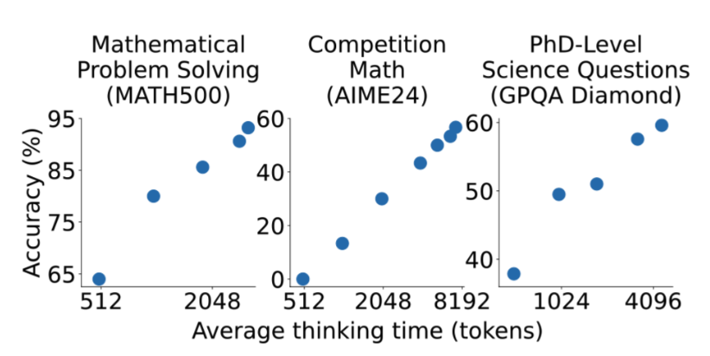
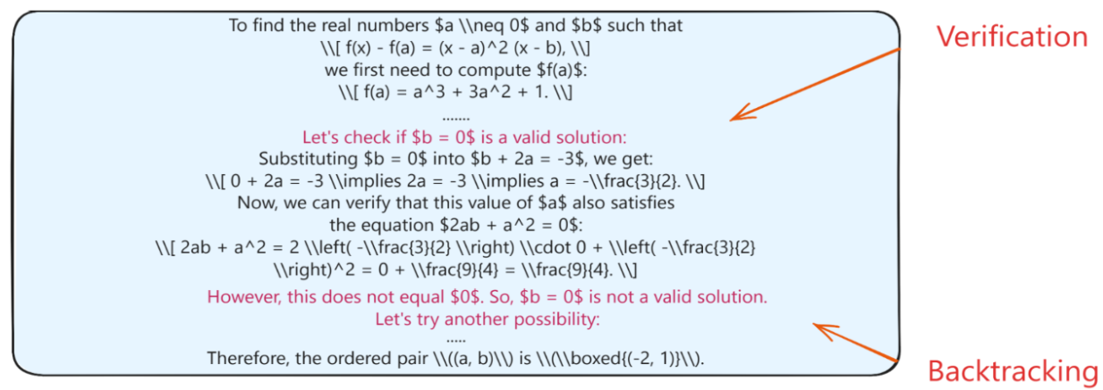
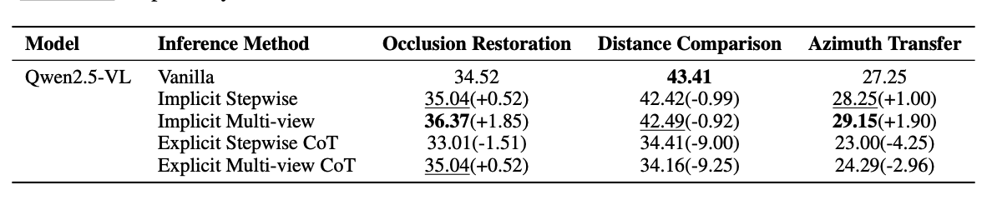
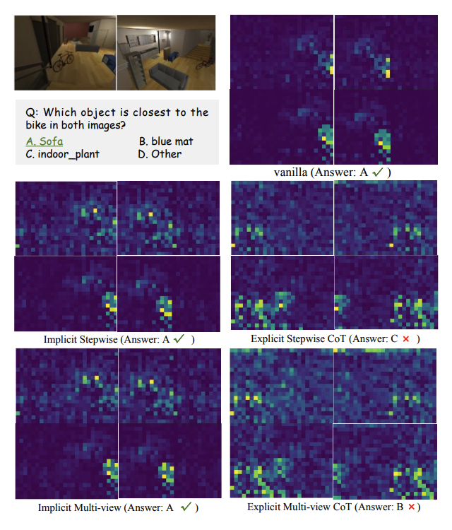
How to scale at inference time
Inference time scaling in text domain
Performance scales with thinking time
Ahah moment in reasoning
Thinking in text domain impair visual spatial reasoning
Notes:
explicit CoT prompting can actually impair spatial understanding
CoT caused the model's attention to diffuse (spread out) or focus too narrowly on the primary subject query, ignoring the critical contextual objects needed for spatial comparison.
https://lilianweng.github.io/posts/2025-05-01-thinking/

Slide 7
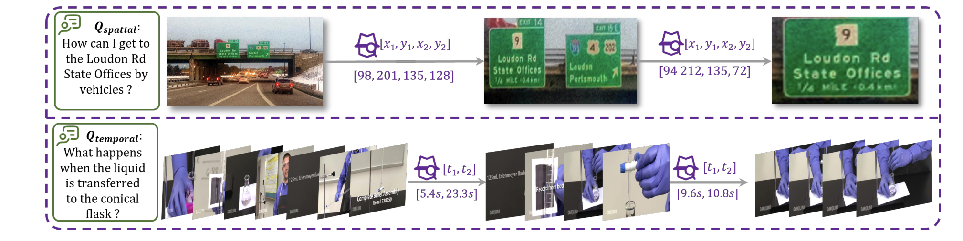
How to scale at inference time
Alternative method other than thinking in text
Think with image
Limitation:
- only guide the model to focus on task-relevant regions
- but does not enable it to extract spatial information
[9] Mind journey: Test-Time Scaling with World Models for Spatial Reasoning
[10] When and How Much to Imagine: Adaptive Test-Time Scaling with World Models for Visual Spatial Reasoning
[11] SpatialDreamer: Incentivizing Spatial Reasoning via Active Mental Imagery
[12] WMNav: Integrating Vision-Language Models into World Models for Object Goal Navigation
[13] Sparse Imagination for Efficient Visual World Model Planning

Slide 8

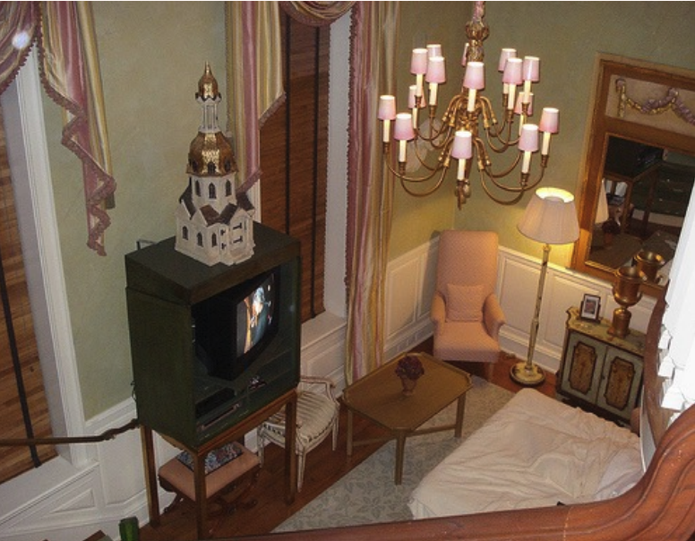






How to scale at inference time
Alternative method other than thinking in text
think with 3d aware tools as an agent
Rely on external tools
1 Think with image
Tool box
Extracted 3D information
Script for verification
Where is the table
Rely on VLM reasoning
think in a semantically rich latent space
…
<think>
Laten embeddings
Notes:
VideoChat-R1.5: Visual Test-Time Scaling to Reinforce Multimodal Reasoning by Iterative Perception

Slide 9
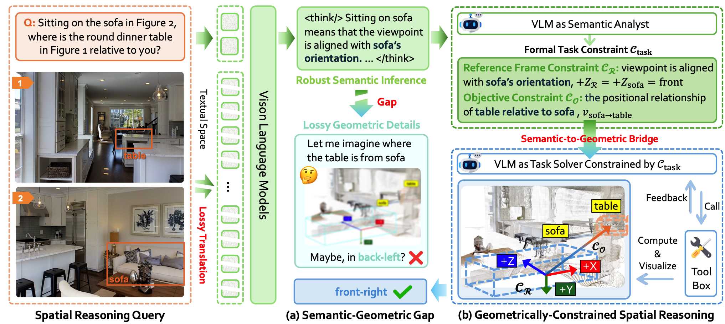
Existing work: Geometrically-Constrained Agent
Existing work: Geometrically-Constrained Agent
Provide a path of separating semantic reasoning from geometric computation

Slide 10
More existing works on thinking with tools
[14] World2Mind: Cognition Toolkit for Allocentric Spatial Reasoning in Foundation Models
[15] Geometrically-Constrained Agent for Spatial Reasoning
[16] RieMind: Geometry-Grounded Spatial Agent for Scene Understanding

Slide 11
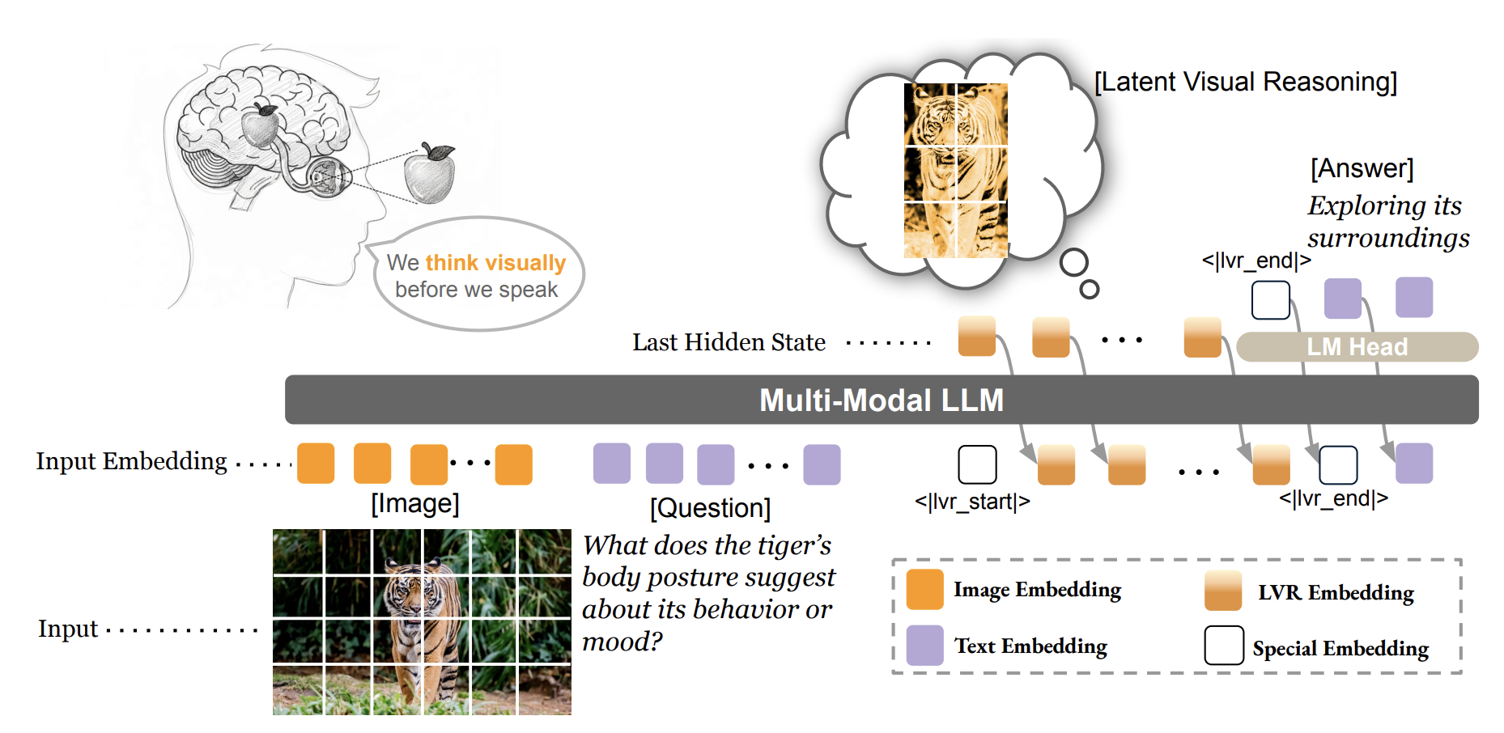
Existing work: Latent spatial reasoning
Motivation
A unified spatial representation should be embedded in continuous latent space, enabling 3D mental modeling for human-like spatial reasoning.
Most of current method focusing on 2D image perception rather than spatial reasoning with necessary 3D latent feature guidance.
The listed papers include some general-purpose multimodal latent-space reasoning methods that are not specifically designed for spatial reasoning, but are still worth reading.

Slide 12
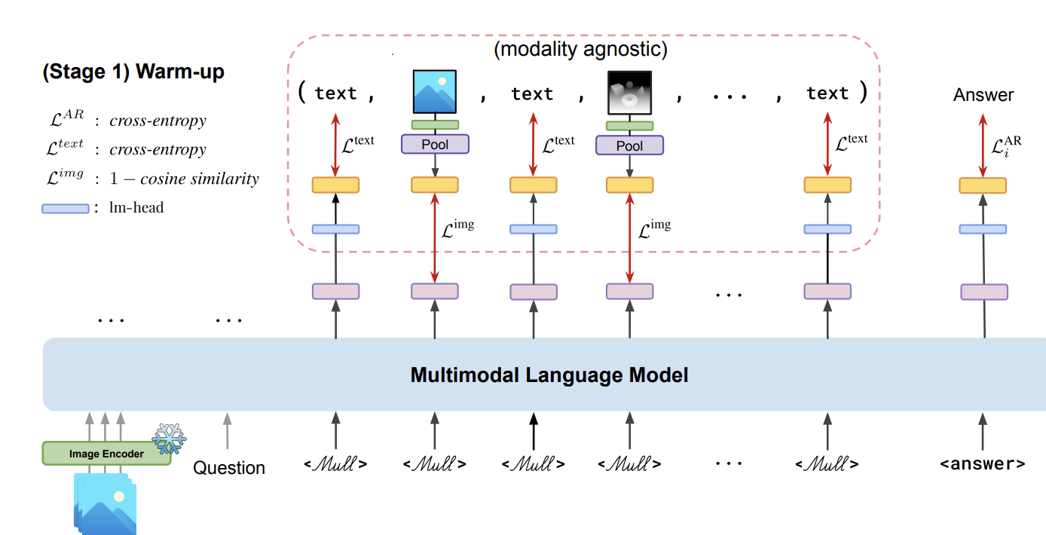
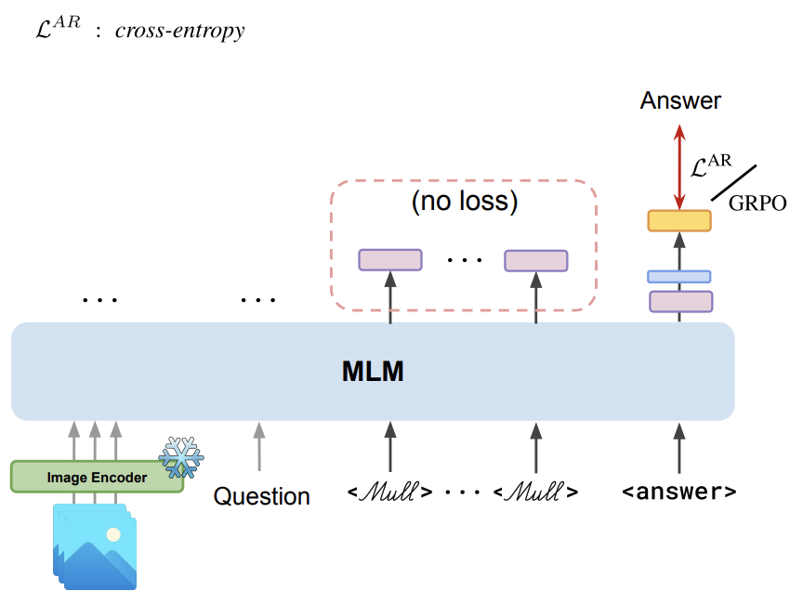
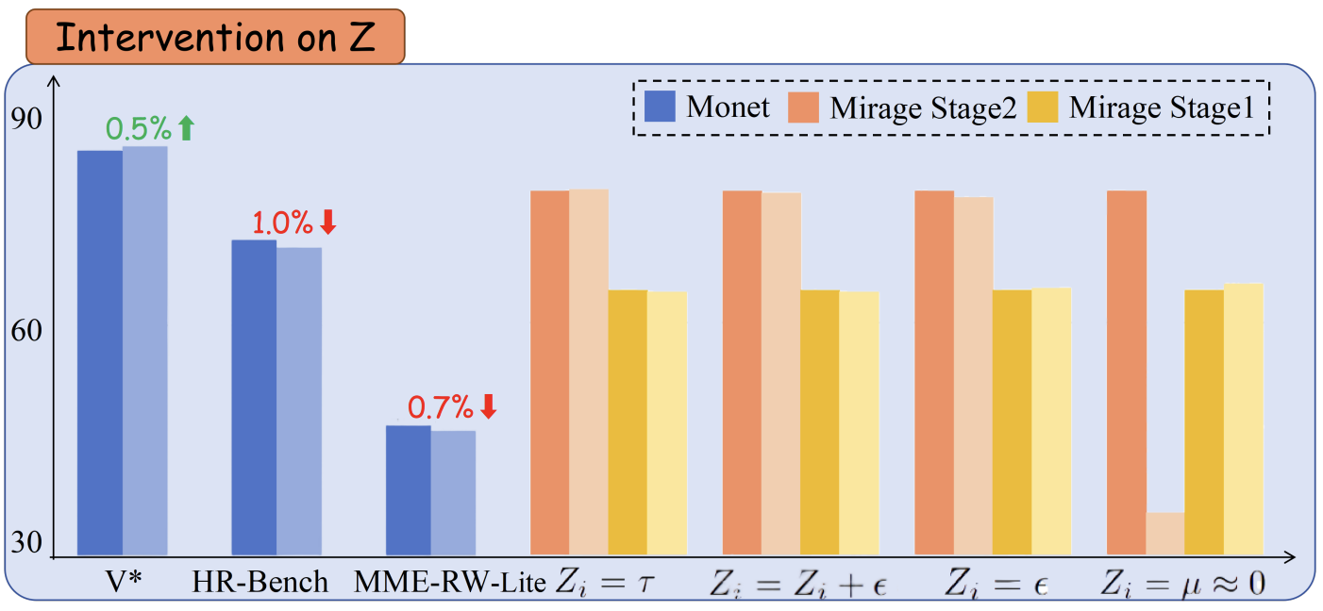
Latent reasoning for spatial reasoning
Three potential pathways
1 latent alignment + RL
1 teach the model the generate token in a semantically rich latent space (e.g. learn to generate VGGT embeddings)
2 does not teach the model how to leverage the generated latent information for reasoning; instead, the reasoning capability relies entirely on reinforcement learning
SFT (alignment)
RL
Any way to guarantee that the model derives its final decision from latent reasoning, rather than relying solely on the raw image and text inputs?

Slide 13
Latent reasoning for spatial reasoning
Three potential pathways
1 latent alignment + RL
[17] Think with 3D: Geometric Imagination Grounded Spatial Reasoning from Limited Views
[18] Monet: Reasoning in Latent Visual Space Beyond Image and Language
[19] CrystaL: Spontaneous Emergence of Visual Latents in MLLMs
[20] Mull-Tokens: Modality-Agnostic Latent Thinking
[21] Reasoning Within the Mind: Dynamic Multimodal Interleaving in Latent Space
[22] Latent Chain-of-Thought for Visual Reasoning
[23] Latent Reasoning VLA: Latent Thinking and Prediction for Vision-Language-Action Models

Slide 14
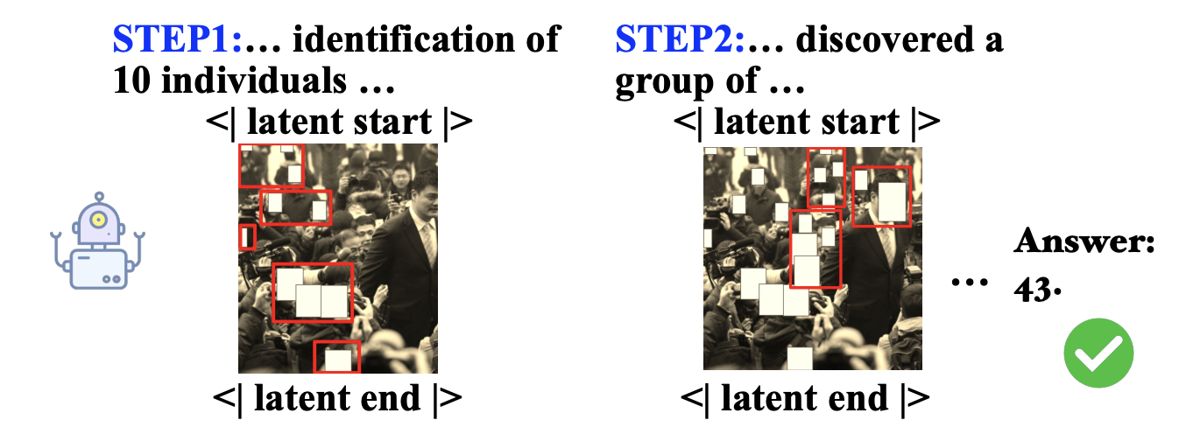
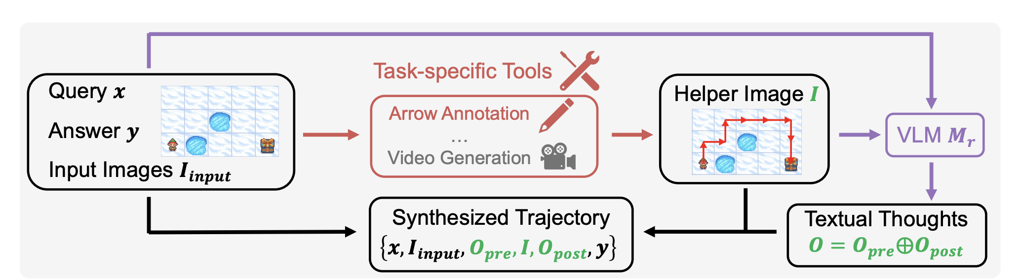
Latent reasoning for spatial reasoning
Three potential pathways
2 guide the reasoning with ground truth reasoning traces
Option 1: teach the model to focus on the correct part of input
Option 2: teach the model with mental imaginary operation
Trace Coherence (Local Plausibility): Do the individual, step-by-step sentences make sense? Are there obvious errors between step A and step B?
Trace Validity (Global Validity): Does the entire chain of thought logically sound that leads to the correct final answer

Slide 15
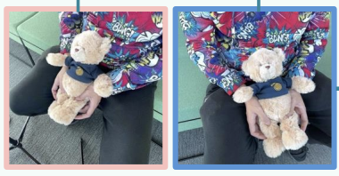
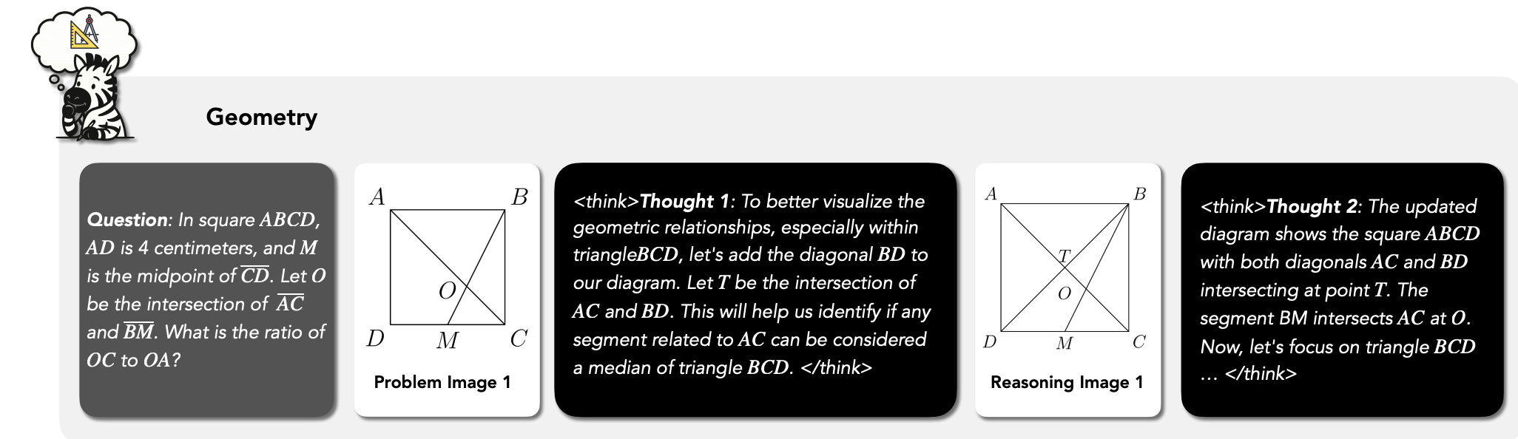
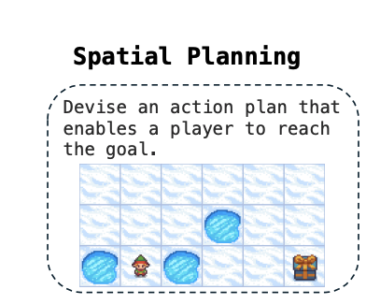
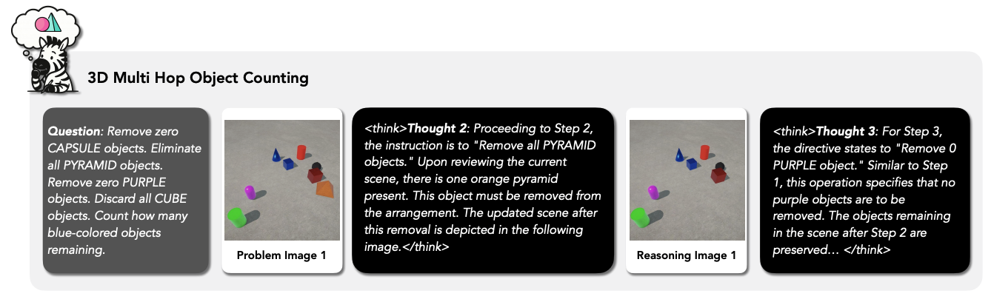
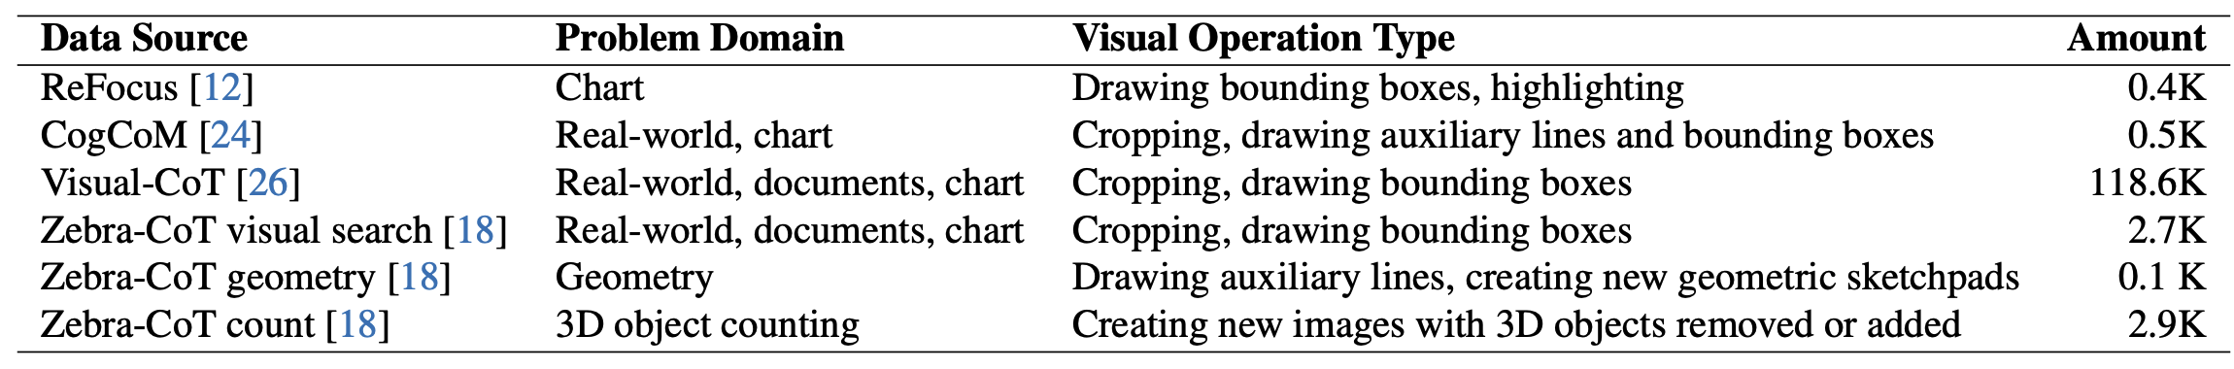
Existing multi-model reasoning data
Highlight task-related region
Caption the input image
In the first image, the teddy bear is rotated sideways …
In the second image, the teddy bear’s face is oriented toward the camera
2D spatial/geometric reasoning with sketch
3D spatial reasoning with toy data
Statistics of monet-sft-125k

Slide 16
Latent reasoning for spatial reasoning
Three potential pathways
2 guide the reasoning with ground truth reasoning traces
[24] Sketch-in-Latents: Eliciting Unified Reasoning in MLLMs
[25] Vision-aligned Latent Reasoning for Multi-modal Large Language Model
[26] Interleaved Latent Visual Reasoning with Selective Perceptual Modeling
[27] VisMem: Latent Vision Memory Unlocks Potential of Vision-Language Models
[28] Multimodal Reasoning via Latent Refocusing

Slide 17
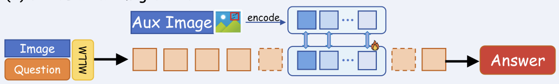
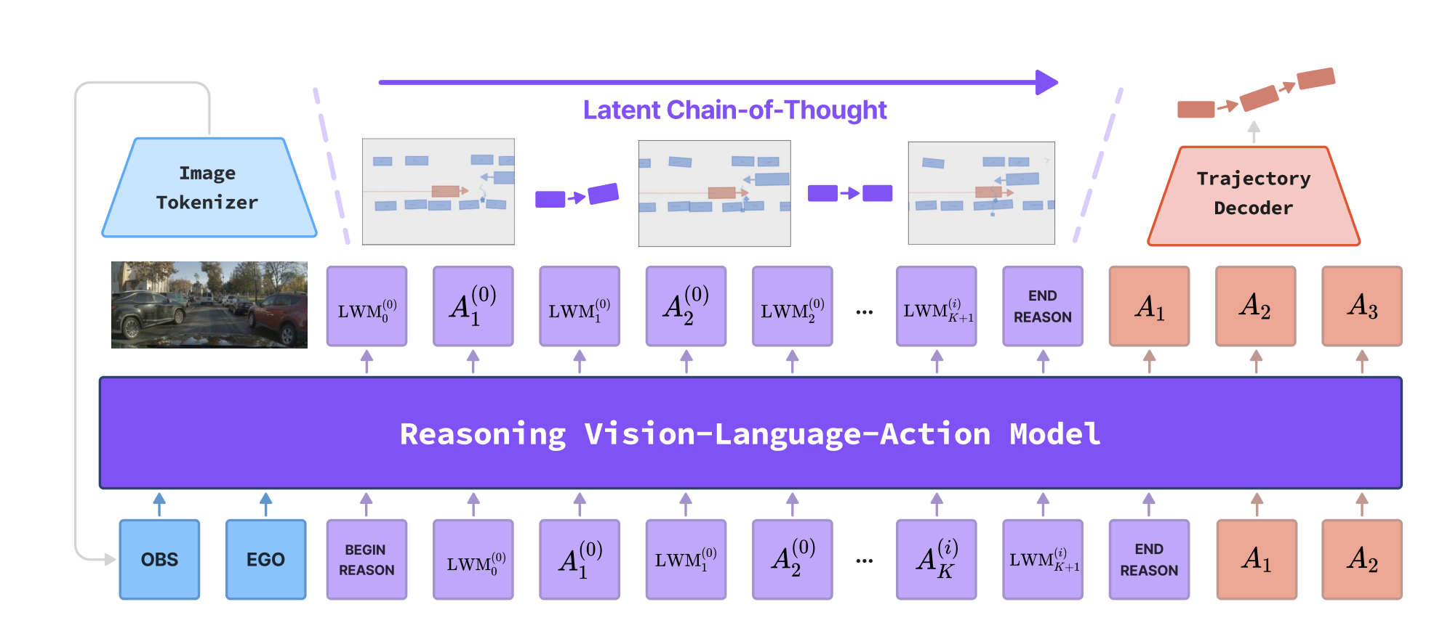
Latent reasoning for spatial reasoning
Three potential pathways
3 world model guided latent reasoning
Advantage: easy to get reasoning trace ground truth (predicted world state based on action)
Latent Token
World Model
Limitation: not applicable to all tasks
Applicable:
Where is object A relative to me if turn right
Future world state (e.g. image after turning)
Condition (action)
Existing work
Not applicable:
What’s the spatial relation between object A and B
What’s the action?

Slide 18
Latent reasoning for spatial reasoning
Three potential pathways
3 world model guided latent reasoning
[29] Latent Chain-of-Thought World Modeling for End-to-End Autonomous Driving
[30] LaST-VLA: Thinking in Latent Spatio-Temporal Space for Vision-Language-Action in Autonomous Driving
[31]CAN WORLD MODELS BENEFIT VLMS FOR WORLD DYNAMICS?
[32]JEPA-VLA: Video Predictive Embedding is Needed for VLA Models
[33]Policy-Guided World Model Planning for Language-Conditioned Visual Navigation

Slide 19
Latent reasoning for spatial reasoning
Imagination Helps Visual Reasoning, But Not Yet in Latent Space
Current latent reasoning method doesn’t involve in reasoning
Input-Latent Disconnect: Dramatic perturbations to the input resulted in negligible changes to the latent tokens.
Latent-Answer Disconnect: Applying interventions directly to the latent tokens, it had minimal impact on the model's final answer.
Limited Visual Encoding: Extensive probing revealed that these latent tokens encode only minimal visual information relevant to the task and exhibit a high degree of similarity across different inputs (the latent tokens quickly collapse into highly similar states and fail to encode rich visual semantics)
Improvement mainly comes from high quality data
1 reproduce Monet under strictly controlled settings to isolate the effect of the latent tokens from the effect of the training data.
2 when using the exact same data source, their reproduced version of Monet showed only marginal gains over the base model on real-world benchmarks

Slide 20
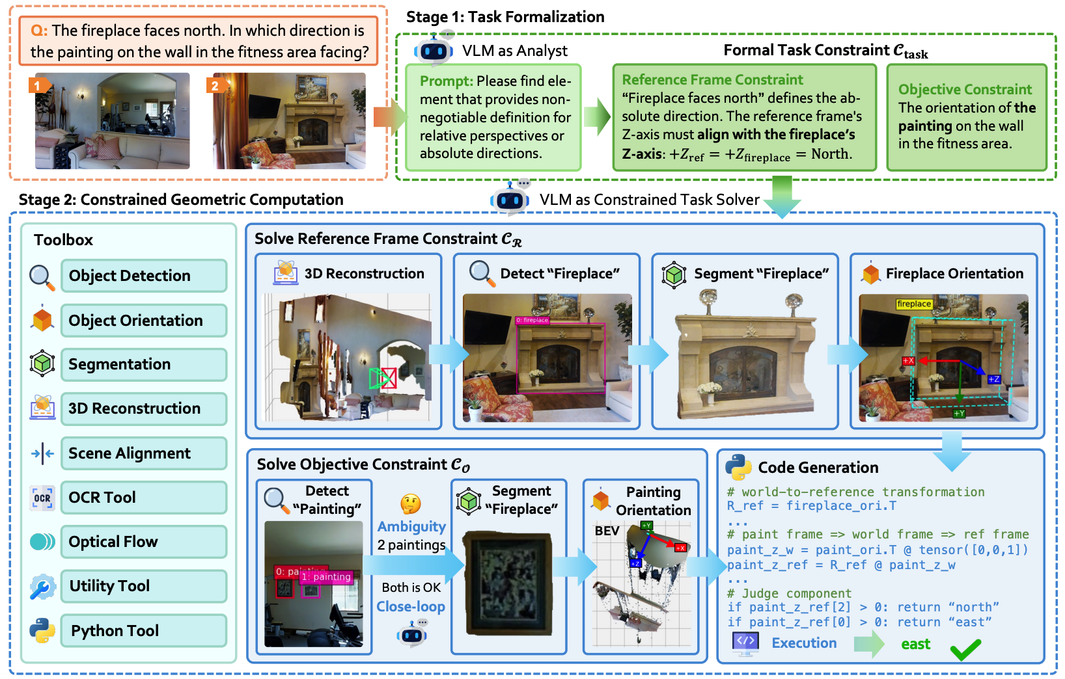


Latent reasoning for spatial reasoning
Existing work: Only highlights task-relevant 2D information, without enabling 3D reasoning.
Highlight task-related region
Caption the input image
In the first image, the teddy bear is rotated sideways …
In the second image, the teddy bear’s face is oriented toward the camera
Our idea: Tool calling agents as a teacher
Agent with 3d tools
Ground truth reasoning path (if the answer is correct)
Encode
Latent reasoning model
<think>
Latent reasoning path

